Slide 1
Access 2016 Module 9
Importing and Exporting Data

Slide 2
Module Objectives
Import data from Excel
Link data
Export data to Excel
Publish data to Word
Merge data with Word
Export data to PDF
Create objects using database templates
Create objects using Application Parts

Slide 3
Import Data from Excel (Slide 1 of 3)
Importing
quickly copy data from an external file into an Access database
Types of files:
Delimited text file: stores one record on each line
Field values: separated by a common character, the delimiter, e.g., comma, tab, or dash
CSV (comma-separated values) file: common example of a delimited text file
XML file: text file containing Extensible Markup Language (XML) tags that identifying field names and data
Microsoft Excel
one of the most common file formats from which to import data into an Access database

Slide 4
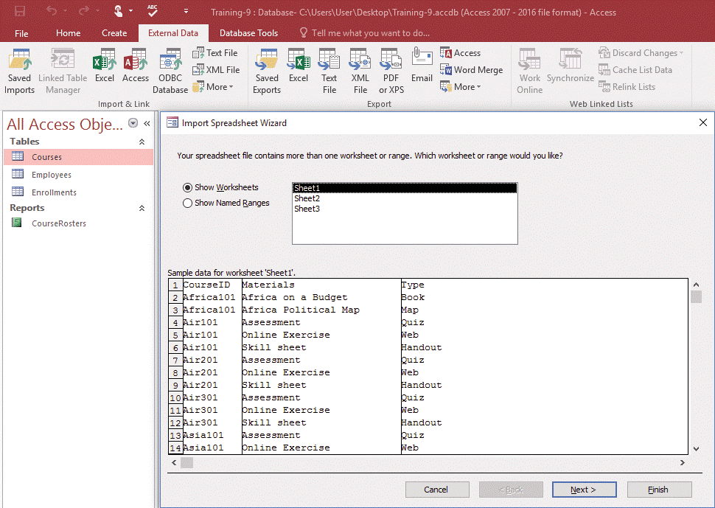
Import Data from Excel (Slide 2 of 3)
Import Spreadsheet Wizard

Slide 5
Import Data from Excel (Slide 3 of 3)
Referential integrity cascade options
Cascade Update Related Fields
If the value in the primary key field of the one table is modified, all values in the foreign key field in the many table are automatically updated
Cascade Delete Related Records
If a record in the one table is deleted, all related records in the many table are deleted

Slide 6
Link Data (Slide 1 of 3)
Linking connects an Access database to data in an external file
Examples: another Access database, Excel spreadsheet, text file, HTML file, XML file, other data sources that support ODBC (Open Database Connectivity)
Linking is different from importing
not copied into the database
data is only physically stored and updated in the original file
can be edited through source program or destination program

Slide 7
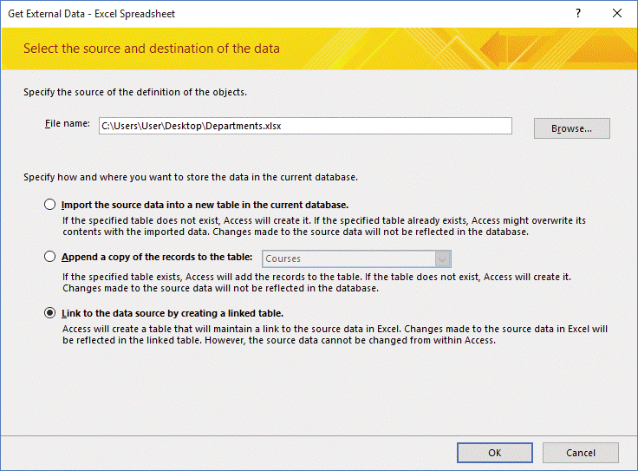
Link Data (Slide 2 of 3)
Get External Data – Excel Spreadsheet dialog box

Slide 8
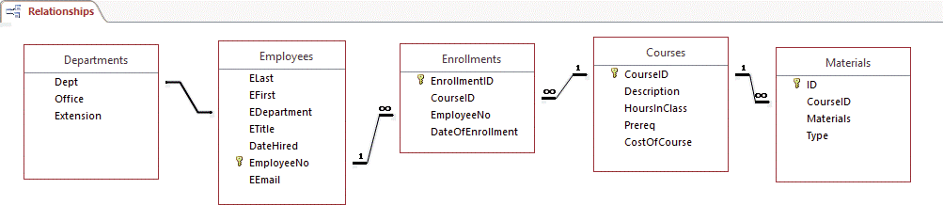
Link Data (Slide 3 of 3)
Referential integrity cannot be enforced with a linked table
Relationships window with linked Departments table
Relationship but not referential integrity

Slide 9
Export Data to Excel (Slide 1 of 2)
Exporting
copies Access information to another database, spreadsheet, or file format.
Can export Access data to other file types
e.g., Excel or Word file types, and in general file formats (text, HTML, and XML)
Can save export steps for re-use

Slide 10
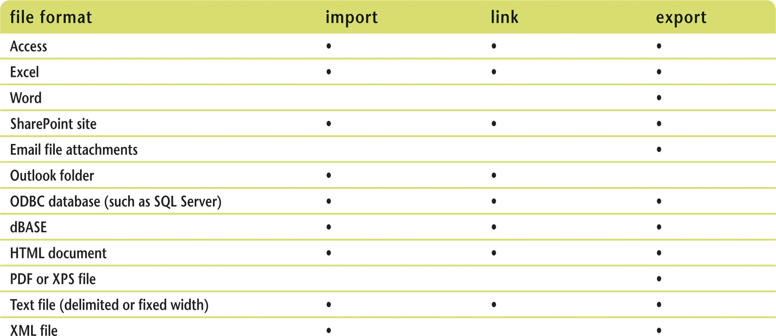
Export Data to Excel (Slide 2 of 2)
File formats that Access can link to, import, and export

Slide 11
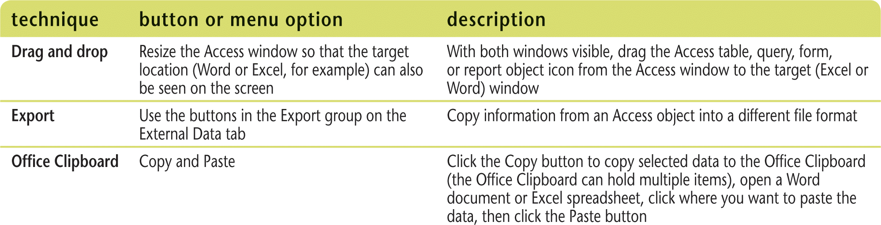
Publish Data to Word (Slide 1 of 2)
Export data from an Access table, query, form, or report into a Word document
Techniques to copy Access data to other applications

Slide 12
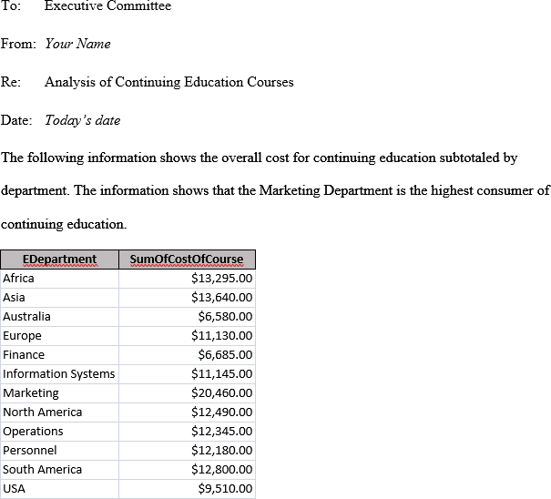
Publish Data to Word (Slide 2 of 2)
Word document with Access data

Slide 13
Merge Data with Word (Slide 1 of 2)
Merge Access data to a Word document as the data source for a mail-merge process
Data from an Access table or query: combined into a Word form letter, label, or envelope to create mass mailing document
Main document
Word document that contains standard text for each form letter
Merge fields
Codes that are replaced with values in the field when mail merge is processed

Slide 14
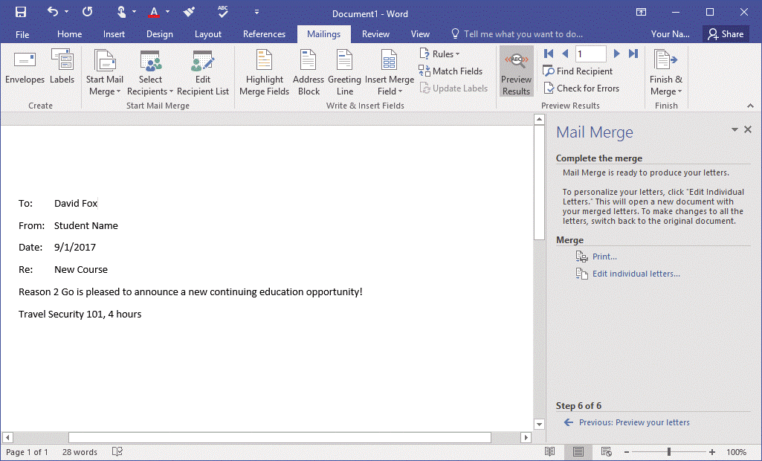
Merge Data with Word (Slide 2 of 2)
Inserting merge fields

Slide 15
Export Data to PDF (Slide 1 of 2)
Portable Document Format (PDF) document
Developed by Adobe
Standard format for exchanging documents
Read with free Adobe Reader software
Can read but not edit or change information
Can email PDF files directly from Access

Slide 16
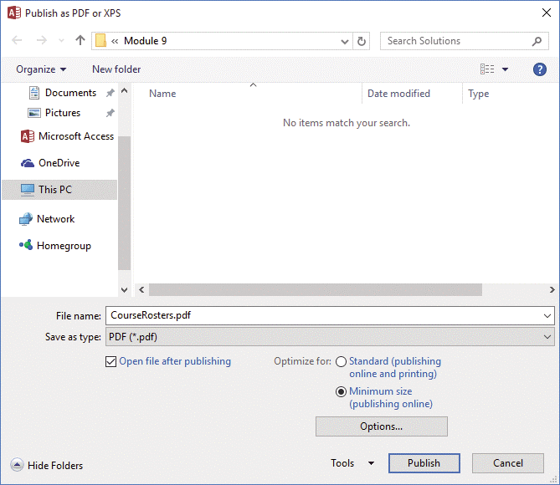
Export Data to PDF (Slide 2 of 2)
Publish as PDF or XPS dialog box

Slide 17
Create Objects using Database Templates (Slide 1 of 3)
Database template
tool used to quickly create a new database based on a particular subject, e.g., assets, contacts, events, or projects
Some templates are included with Access install
Additional templates available from Microsoft Office Online (organized by category)
Two types of database templates
Desktop (traditional) – available to users who work with Access on computers over a local area network
Web (Access) app – database published to a SharePoint server
Database templates are constantly changing

Slide 18
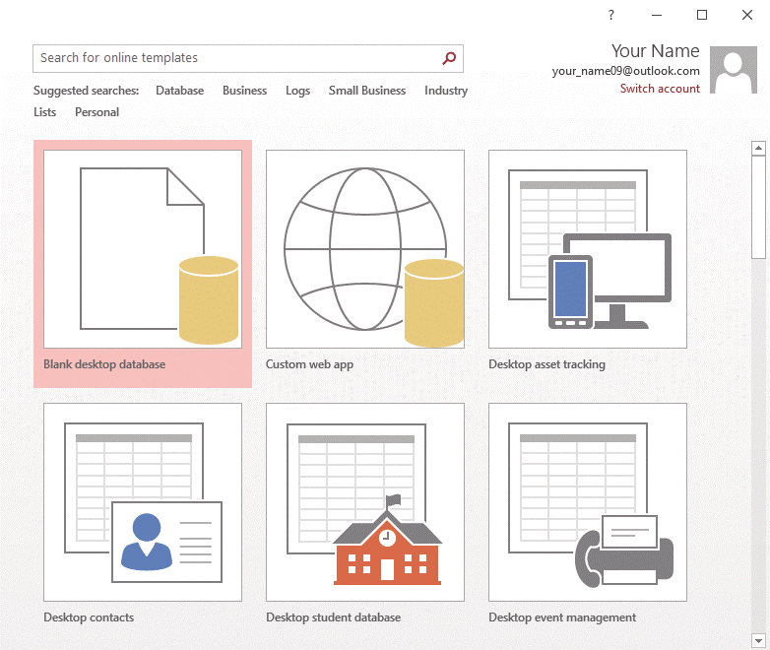
Create Objects using Database Templates (Slide 2 of 3)
Creating a database from a template
Custom web app template
Desktop template

Slide 19
Create Objects using Database Templates (Slide 3 of 3)
Startup form – opens automatically when the database opens
Click the File tab, click Options, then click the Current Database category in the Access Options dialog box
Use the Display Form drop-down list, then specify which form should automatically open when the database is started

Slide 20
Create Objects using Application Parts (Slide 1 of 2)
Application Parts
object templates that create objects, e.g., tables, forms, and reports
Several table, form and report templates available
Can also import objects from another database
Queries, forms, reports

Slide 21
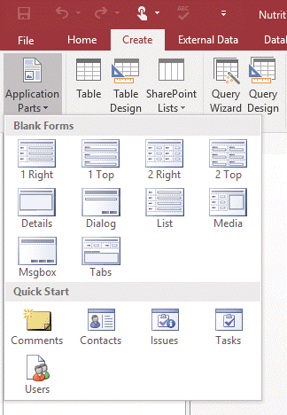
Create Objects using Application Parts (Slide 2 of 2)
Application Parts list

